Slide 1
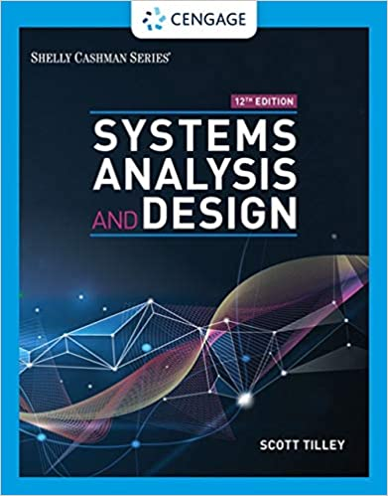
Requirements Engineering
(Chapter 04)
MIS 372 Spring 2022

Slide 2

Do Check-in First
https://forms.office.com/r/nwsEdTduTE

Slide 3
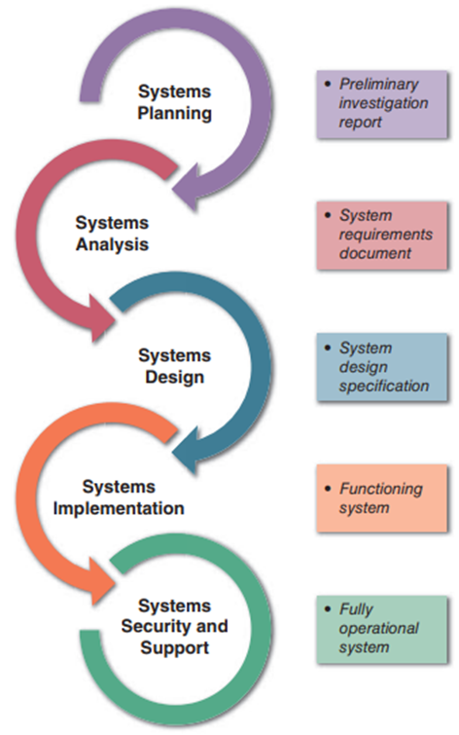
Where We Are in SDLC

Slide 4
Learning Objectives
1. Overview of System Requirements
2. Gathering Requirements
3. Visualizing Requirements
4. Validating Requirements
Appendix A. Tools (Qualtrics, Draw.IO)
Appendix B. Requirements Gathering in Agile Projects

Slide 5
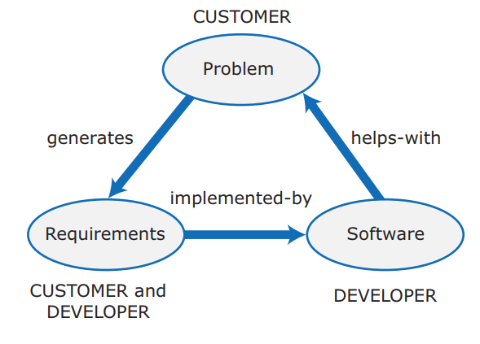
1. Overview of System Requirements
A system requirement is a characteristic or feature that must be included in an information system to satisfy business requirements.
An important benchmark to measure the overall acceptability of the final system.

Slide 6
Main Activities in Requirements Engineering
Requirements Engineering
Gathering
Representing
Validating

Slide 7
Type of Requirements
Functional Requirements
Statements of the services a system provides
Examples:
The website shall report online volume statistics every four hours and hourly during peak periods
The inventory system shall produce a daily report showing the part number, description, quantity on hand, etc.
Each input form must include date, time, product code, customer number, and quantity.

Slide 8
Type of Requirements (cont.)
Non-functional Requirements
Statements of operational system constraints
Example:
Data entry screens must be uniform
The system must support 25 users online simultaneously
Response time must not exceed four seconds

Slide 9
Type of Requirements (cont.)
Functional Requirements | Non-Functional Requirements
A functional requirement defines a system or its component. | A non-functional requirement defines the quality attribute of a software system.
It specifies “What should the software system do?” | It places constraints on “How should the software system fulfill the functional requirements?”
Functional requirement is specified by User. | Non-functional requirement is specified by technical peoples e.g., Architect, Technical leaders, etc.
It is mandatory. | It is not mandatory.
It is captured in use case. | It is captured as a quality attribute.
Defined at a component level. | Applied to a system as a whole.
Helps you verify the functionality of the software. | Helps you to verify the performance of the software.
Functional Testing like System, Integration, End to End, API testing, etc are done. | Non-Functional Testing like Performance, Stress, Usability, Security testing, etc are done.
Usually easy to define. | Usually more difficult to define.
From: https://www.geeksforgeeks.org/functional-vs-non-functional-requirements/

Slide 10
URL Shortener Example
URL shortening is a technique on the World Wide Web in which a Uniform Resource Locator (URL) may be made substantially shorter and still direct to the required page.
Example:
Original URL: https://example.com/assets/category_B/subcategory_C/Foo/
Shortened URL: https://sho.rt/Foo
Well-known service providers:
Bitly.com, tinyurl.com, shorturl.at

Slide 11
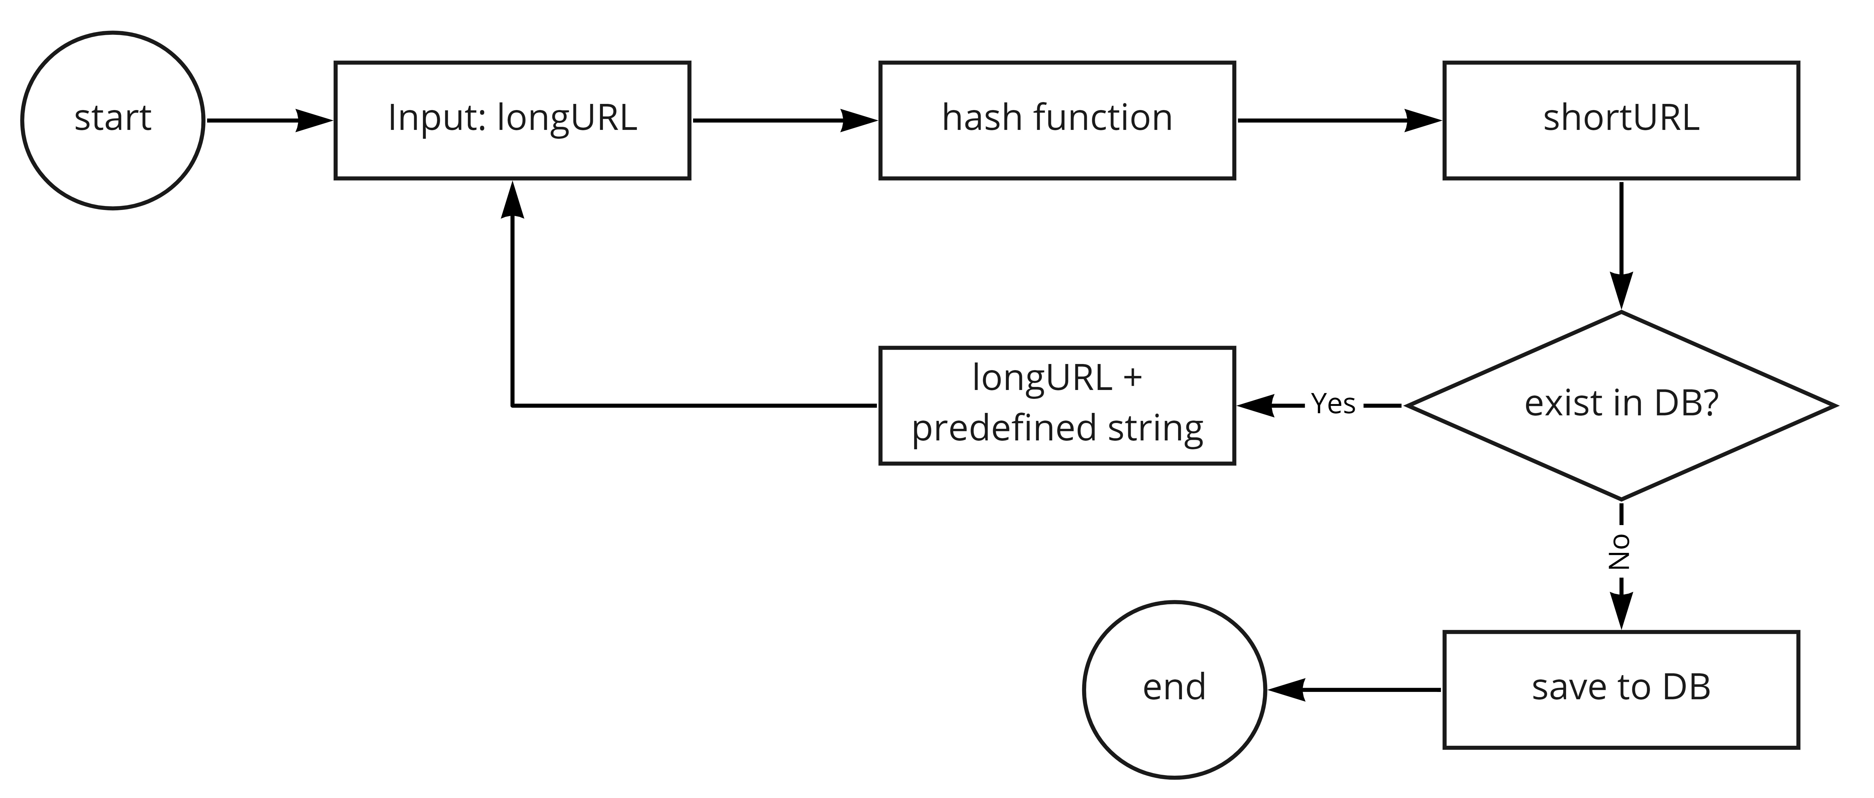
Functional Requirements

Slide 12
Functional Requirements (cont.)
When requested with a short URL, for example, https://short.url/OIJBS8VL, if the server found a match, then redirect the request to the longURL.
DB table in Server

Slide 13
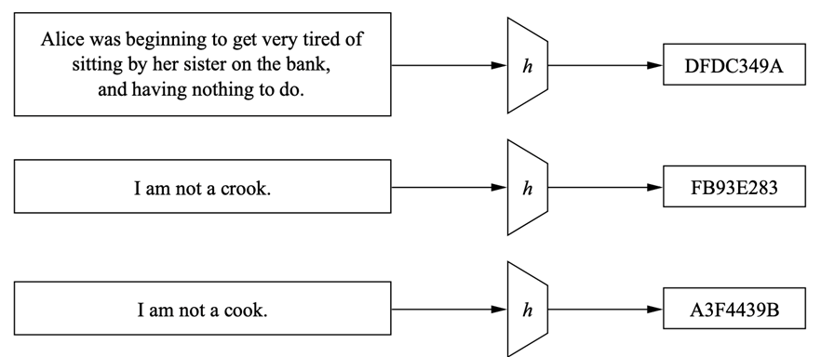
Hash Function
A hash function is any function that can be used to map data of arbitrary size to fixed-size values.
Original Message
Same Hash Function/Algorithm
Hash Value

Slide 14
Hash Function
In the Linux environment, test the following:
# assume you already have wget tool in your Linux
# the file to be downloaded is a text file with a long URL
$ wget www.compsaver.net/SAD/dummyLongURL.txt
$ sudo apt install rhash
$ rhash -C dummyLongURL.txt

Slide 15
Non-functional Requirements
Traffic volume each day
Length of shortened URL (or hash value)
CRC32 ➔ 8 characters
Characters allowed in shortened URL
Alphanumeric ➔ 62 characters (26 + 26 + 10)
How long shortened URL will remain in the record?
Length of Hash and Maximum Number of URLs

Slide 16
Non-functional Requirements (cont.)
Write operation: 100 million URLs are generated per day.
Write operation per second: 100 million / 24 /3600 = 1160
Read operation: Assuming ratio of read operation to write operation is 10:1, read operation per second: 1160 * 10 = 11,600
Assuming the URL shortener service will run for 10 years, this means we must support 100 million * 365 * 10 = 365 billion records.
Assume average URL length is 100.
Storage requirement over 10 years: 365 billion * 100 bytes * 10 years = 365 TB

Slide 17
Important Non-Functional Requirements
Scalability
Ability to handle increased business volume and transactions
Security
Make systems harder to infiltrate
Total Cost of Ownership
Direct and indirect costs

Slide 18
2. Gathering Requirements
First step in requirements engineering process.
Various techniques will be used
Interactive methods
JAD, RAD, Interview, survey
Nonobtrusive methods
Documents review, ethnographic survey, sampling, research

Slide 19
A Series of Questions to Begin with
What business functions are supported by the current system?
What strategic objectives and business requirements must be supported by the new system?
What are the benefits and TCO of the proposed system?
What transactions will the system process?
What information do users and managers need from the system?
Must the new system interface with legacy systems?
What procedures could be eliminated by business process reengineering?
What security issues exist? What risks are acceptable?
What budget and timetable constraints will affect systems development?

Slide 20
Fact-finding Plan
Requirement elicitation or fact-finding
5W1H
Who?
What?
Why?
Where?
When?
How?
References:
Company directory
Job descriptions
Work schedule
Employee tenure
Office location
Building layout
Organizational chart

Slide 21
Different Perspectives on Interviews
Perspectives on Interview
Neopositivist
Romantic
Localist
The interviews are often associated with the complex social situations.
Authentic reflections vs. hackneyed scripts?
How to deal with interviews?

Slide 22
Neopositivist Perspective
Neopositivist approach views the interview as an instrument with which to elicit knowledge from the subject for transmission to the interviewer.
The subject is seen as an expert and a vessel-of-answers.

Slide 23
Romantist Perspective
The romantic approach views the interview as a conversation, albeit one in which the interviewer takes more than s/he gives.
At the center of the romantic perspective is the desire to ‘really know’ the individual and to hear his/her genuine voice.
The reality is interpreted and constructed, not discovered.
Indeed, one of the researcher's objectives is to activate and stimulate the interviewee's interpretive capabilities.

Slide 24
Localist Perspective
The localist approach is skeptical of the interview as a window on social reality. The interview no longer holds a privileged position as an investigative instrument.
The contextual factors such as the interviewer's age, gender and credentials significantly impact the narratives that emerge from the interview.
The authenticity of the accounts as reflective of the interviewee's experience is questionable.
Localists also challenge the interviewee's role as knowledgeable expert and deny the possibility of capturing social reality and of exploring meanings from a native point of view.

Slide 25
Administrative Details in Arrange Interview
Determine the people to interview
Establish objectives for the interview
Develop interview questions
Prepare for the interview
Conduct the interview
Document the interview
Evaluate the interview

Slide 26
Developing Interview Questions
Avoid leading questions
Open-ended questions encourage spontaneous and unstructured responses
Close-ended questions limit the response
Range-of-response questions limit the response

Slide 27
Open-Ended Questions Examples
What are users saying about the new system?
How is this task performed?
Why do you perform the task that way?
How are the checks reconciled?
What added features would you like to have in the new billing system?

Slide 28
Close-Ended Questions Examples
How many personal computers do you have in this department?
Do you review the reports before they are sent out?
How many hours of training does a clerk receive?
Is the calculation procedure described in the manual?
How many customers ordered products from the website last month?

Slide 29
Range-of-Response Questions
On a scale of 1 to 10, with 1 the lowest and 10 the highest, how effective was your training?
How would you rate the severity of the problem: low, medium, or high?
Is the system shutdown something that occurs never, sometimes, often, usually, or always?

